Slide 1


HANDBOOK 2025
Final Contest Whistling Moran Nairobi

Slide 2
#3 TRACK

Slide 3
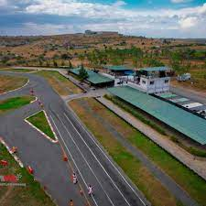

Slide 4
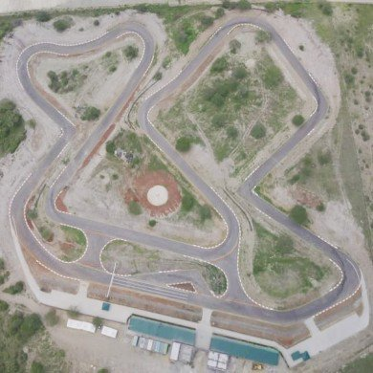
#3 TRACK

Slide 5
Saturday,19.07.2025
FINAL COMPETITION TIME TABLE
07:00 Breakfast
08:00 Arrival
09:00 Start - Competition
13:00 Lunch
14:00 Competition
16:00 Completion
17:00 Award Ceremony for the Award Ceremony
#1 AGENDA

Slide 6
NO.1: EMERGENCY MANAGEMENT – TIRE CHANGE
NO. 2 BRAKING AVOIDANCE OF OBSTACLES – SOAPY WATER
NO.3 : WET AND DRY SLALOM
NO.3: BOWL SLALOM
NO.4: OFF ROAD – (OFF-ROAD TERRAIN)
NO.6: ROLL CAR
TASKS

Slide 7
LADIES ACTIVITIES
NO.1: EMERGENCY MANAGEMENT – TIRE CHANGE
NO. 2 BRAKING AVOIDANCE OF OBSTACLES – SOAPY WATER
NO.3: BOWL SLALOM
NO.4: OFF ROAD – (OFF-ROAD TERRAIN)

Slide 8
KEY GUIDELINES
After registration and confirmation by IT and Registration team
All participants to sign indemnity forms from Whistling Moran
All participants to be tagged with 6 paper wrist of different colours symbolizing the various task
TASK 1 - White
TASK 2 – Purple
TASK 3 - Yellow
TASK 4 - Green
TASK 5 - Blue
TASK 6 – Red
All participants will receive a briefing then distributed to various task
Key asessors will Under go a scoring training on Wednesday and dry Run on Friday at Track – Whistling Moran

Slide 9
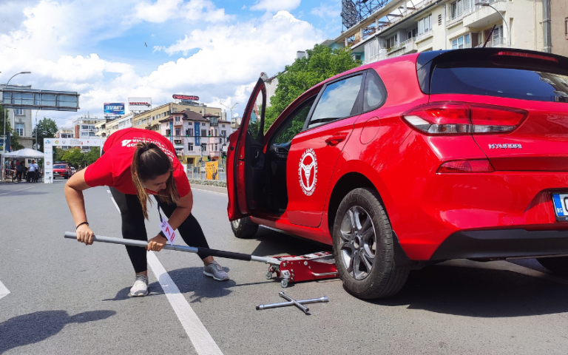
NO.1: EMERGENCY – TIRE CHANGE
DESCRIPTION:
Vehicle: 01 Vehicle:
The aim of the exercise is change tire wheel as error free, and as quickly as possible, a vehicle with intact wheels.
Surface: tarmac.
Starting Equipment set up will be order will be arranged.
Finish re-arrange in a garage.
Proper protective gear must be worn.
Penalties:
Wheel Spanner arrangement + 20 sec
Proper Jacking + 20 sec
Participant position + 20 sec
Wrong Tire fixing + 30 sec
Score:
The scoring is based on the fastest time 5mins then added penalty seconds. Time + penalty seconds.
For example, if the competitor completes the course in 5min, but wrong use of wheel spanner, Participant position, the result is: 00:05:00+20+20 = 00:05:40.00
# TASKS NO. 1
Notes:
9

Slide 10
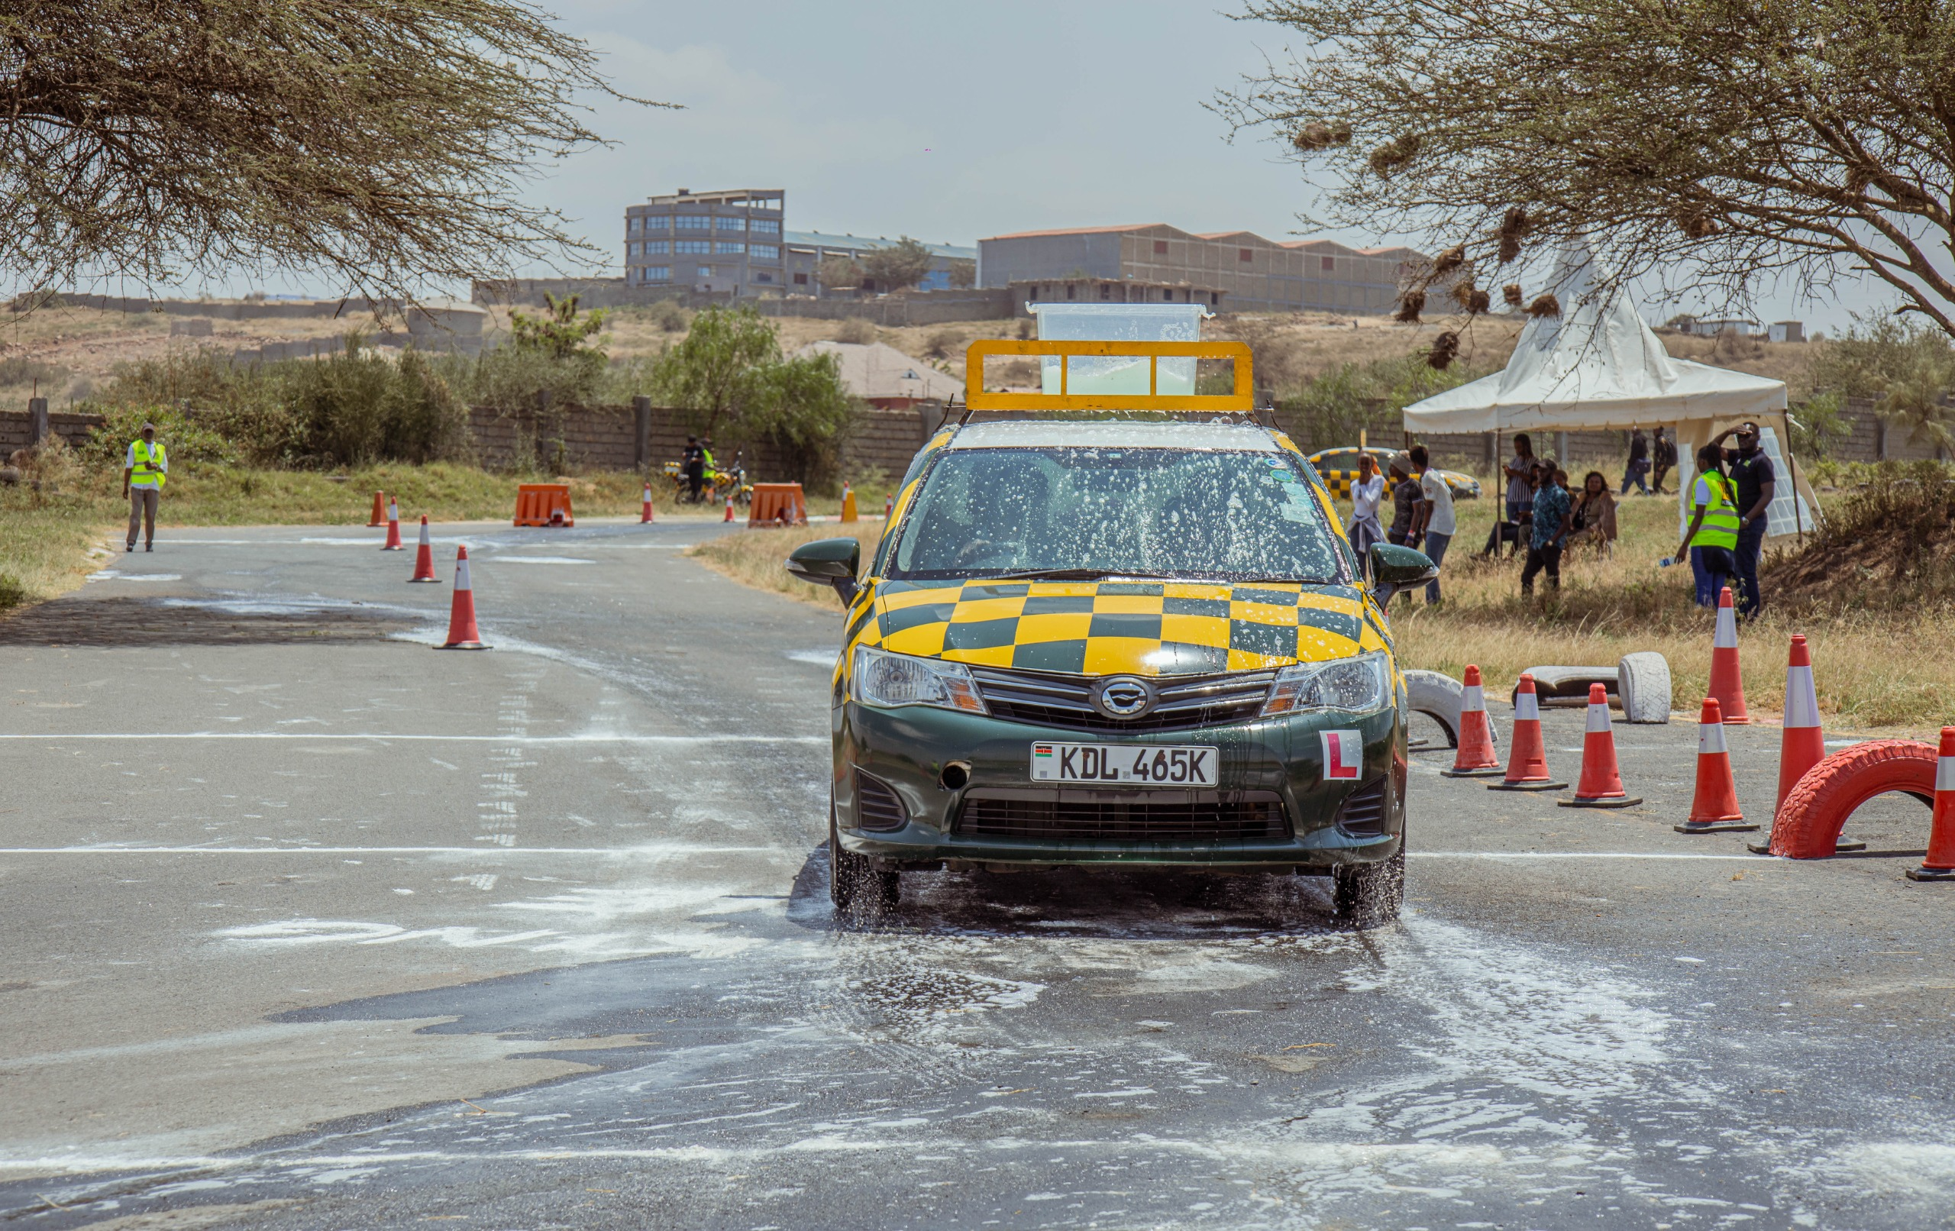
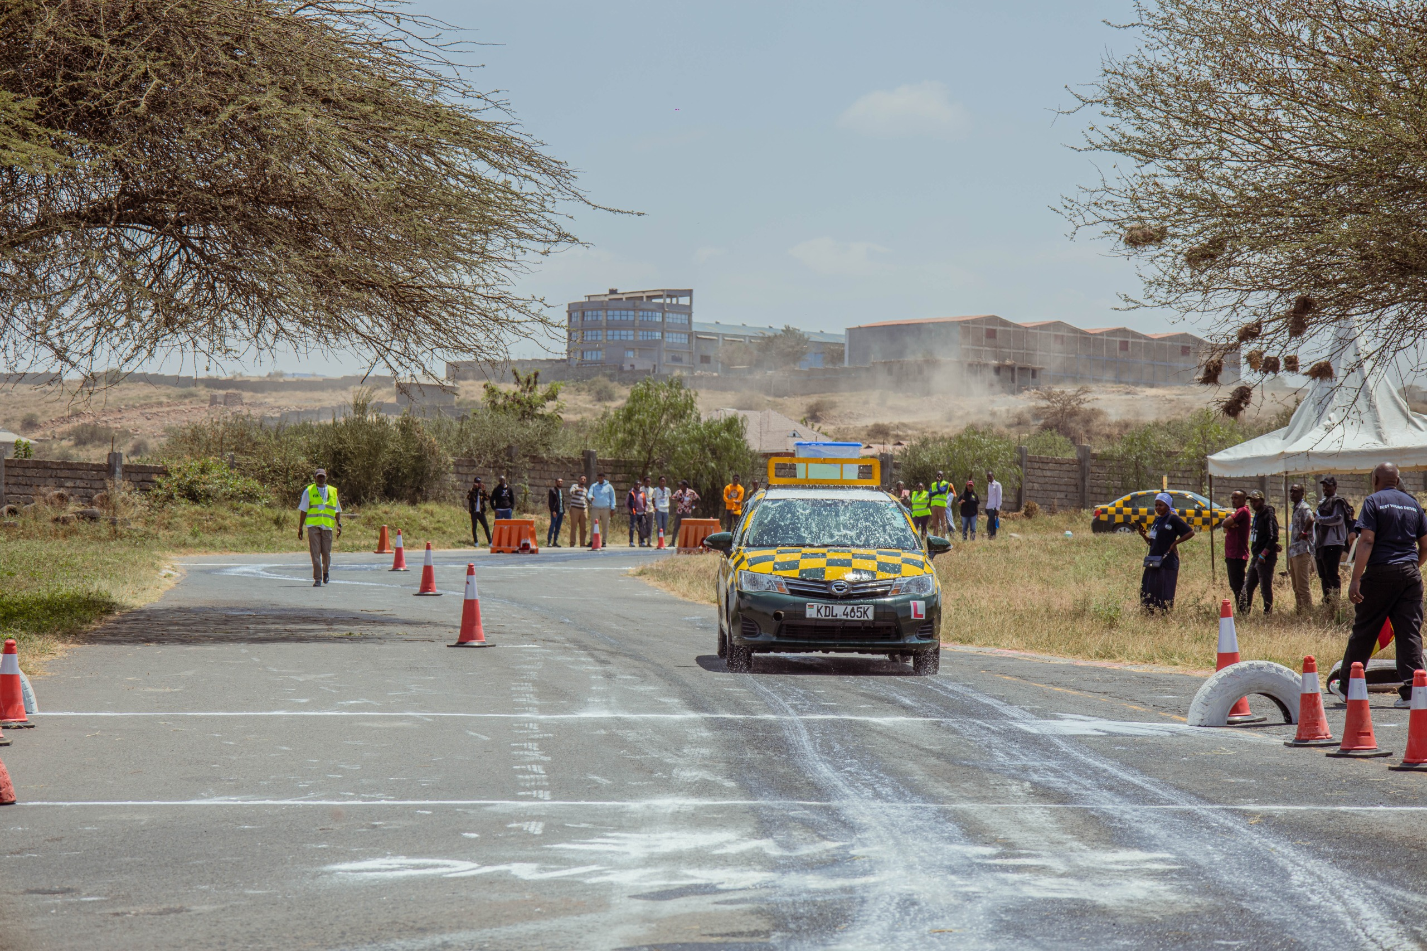
NO.2: BRAKING – AVOIDING OBSTACLES
DESCRIPTION:
Vehicle: 01 Vehicle:
The aim of the exercise is to drive a course on a slippery surface with a certain speed and not to hit any obstacles.
Surface: slippery surface
Speed is measured by mobile system.
Starting order will be drawn.
Seat belts must be worn.
Obstacles will be drawn
Speed:
Minimum speed of 45 kmh
Top speed of 60 kmh
Penalties:
Cone contact - 05 km/h
Under speed (less than 45 km/h) - 10 km/h
Overspeed (over 60 km/h) - 20 km/h
Stopping before or After the obstacle line - 20 km/h
* “The obstacles means a marked exact stopping line on the surface.
Score:
The result is based on the driven speed minus any possible penalties in kmh. For example, if the driven speed is 50kmh and 2 cones are hit, the result is: 50 – 5 – 5 = 40 points.
# TASKS NO 2

Slide 11
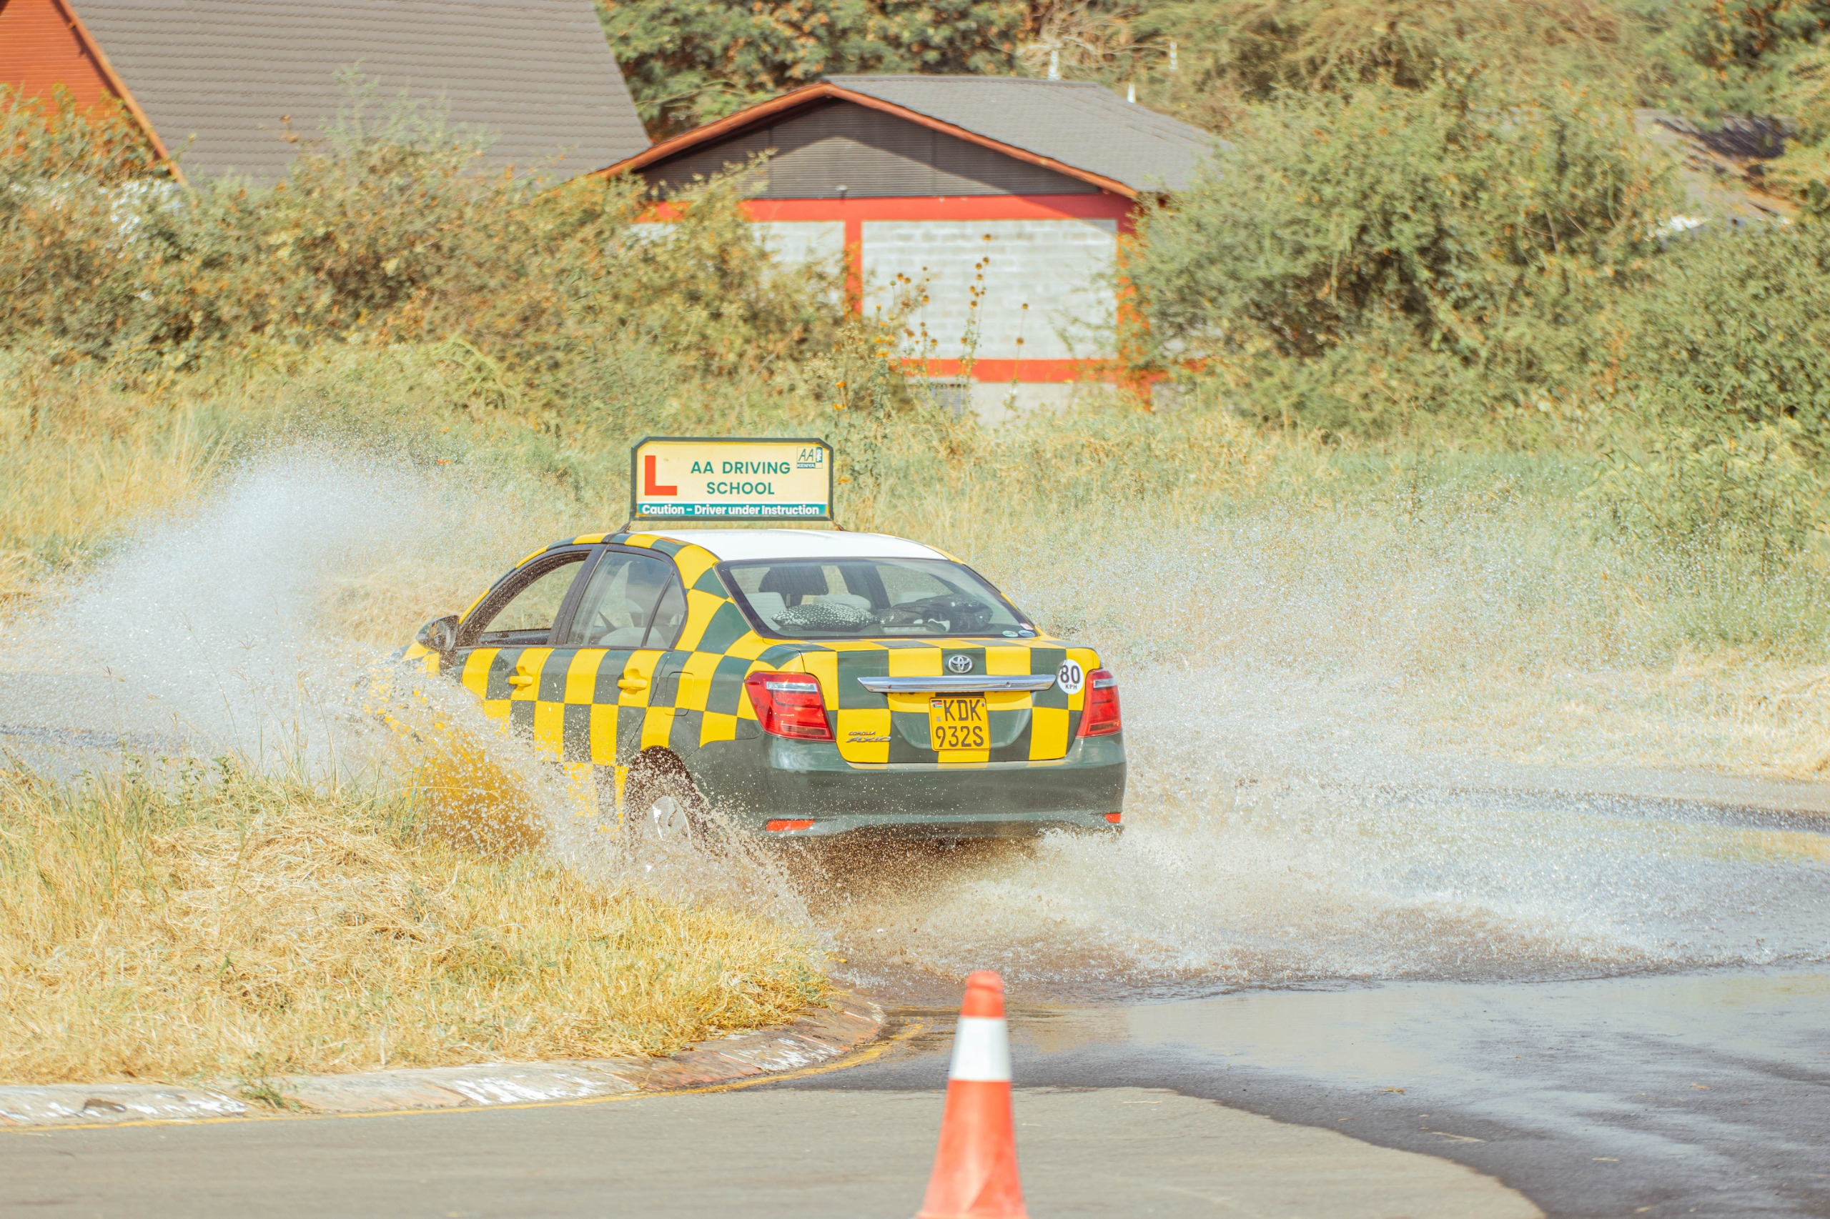
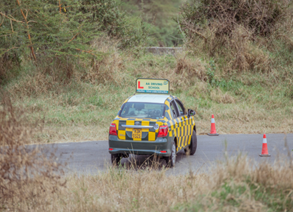
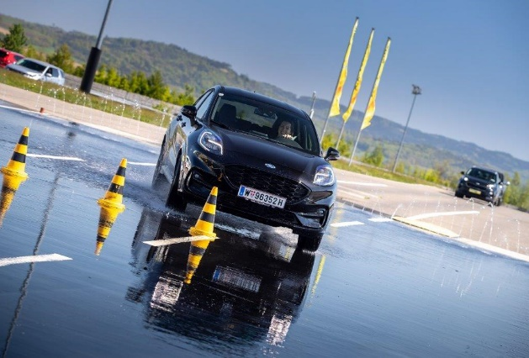
NO3. WET & DRY SLALOM
.2: CAR CONTROL – SPIN PLATE
DESCRIPTION:
Vehicle: 01
The aim of the exercise is to bring a vehicle back into a stable driving condition between 45 and 60 kmh after the rear loses grip.
Surface: slippery surface
Starting order will be drawn.
Seat belt must be worn.
Speed:
Minimum speed of 45 kmh
Top speed of 60 kmh
Penalties:
Cone contact - 05 km/h
Under speed (less than 45 km/h) - 10 km/h
Overspeed (over 60 km/h) - 20 km/h
Spin - 20 km/h
Leaving the Track - 20 km/h
Score:
The result is based on the driven speed minus any possible penalties in kmh. For example, if the driven speed is 50kmh and 2 cones are hit, the result is: 50 – 5 – 5 = 40 points.
#TASKS NO 4

Slide 12
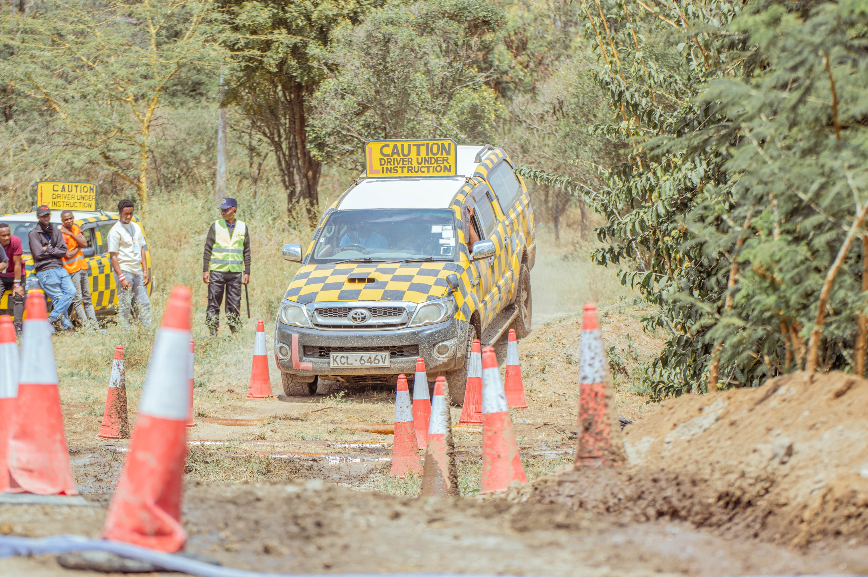
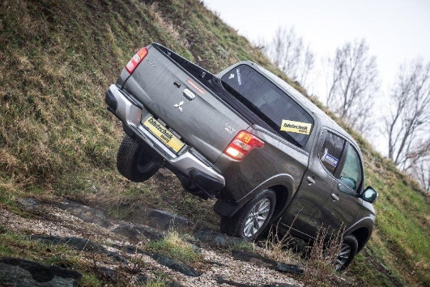
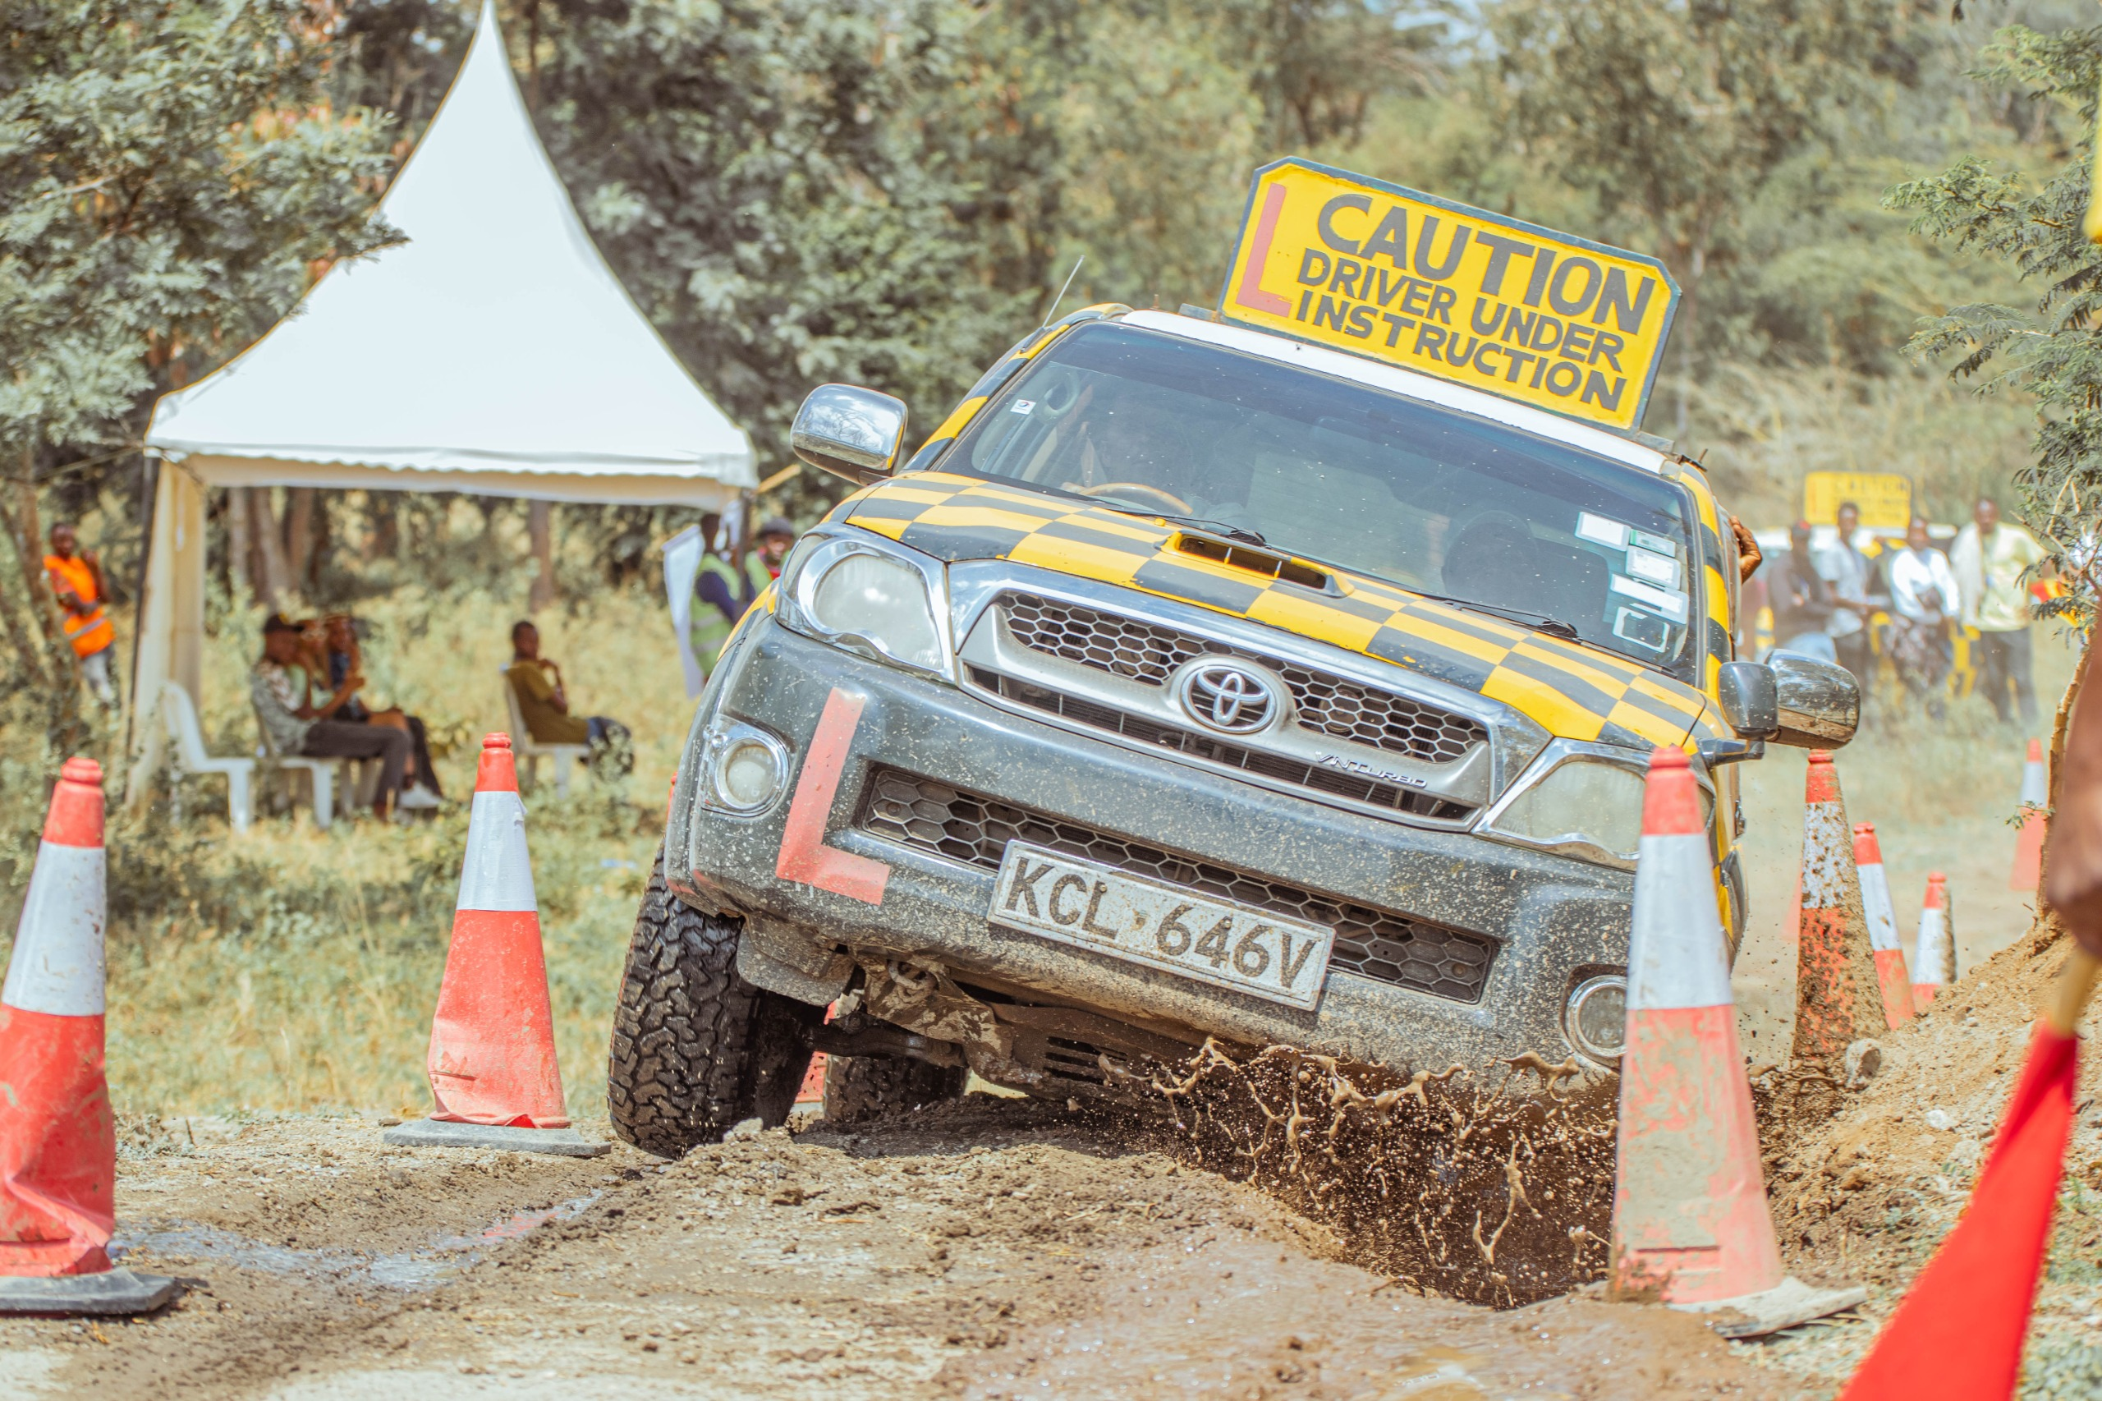
NO.4: OFF ROAD – (OFF-ROAD TERRAIN)
DESCRIPTION:
Vehicle: 02 vehicles: identical Ford Ranger with identical tires
The aim of the exercise is to complete a marked course as error free as possible under a maximum time.
Surface: gravel and tracks
The marking is based on penalty points (0 penalty points best possible rating) and a measured time. Maximum time = 5 mins.
Starting order will be drawn.
Standing start (gate)
Finish in garage (target garage).
2nd competition vehicle can start, if the 1st still on track, if both participant and the instructor agree.
If two competitors have the same penalty points, then the best time counts.
Seat belt must be worn.
Penalties:
Wheels stopped 01 penalty point
Reversing (incl. stopping) 03 penalty points
Indicator falls (ball) or touches pole 06 penalty points
Leaving the imaginary line with all wheels (missing the gate) 06 penalty points
Exceeding the maximum time 10 penalty points
Score:
If the wheels stop twice and one indicator falls, the penalties are: 01 + 01 + 06 = 08 penalty points.
# TASKS NO. 4

Slide 13
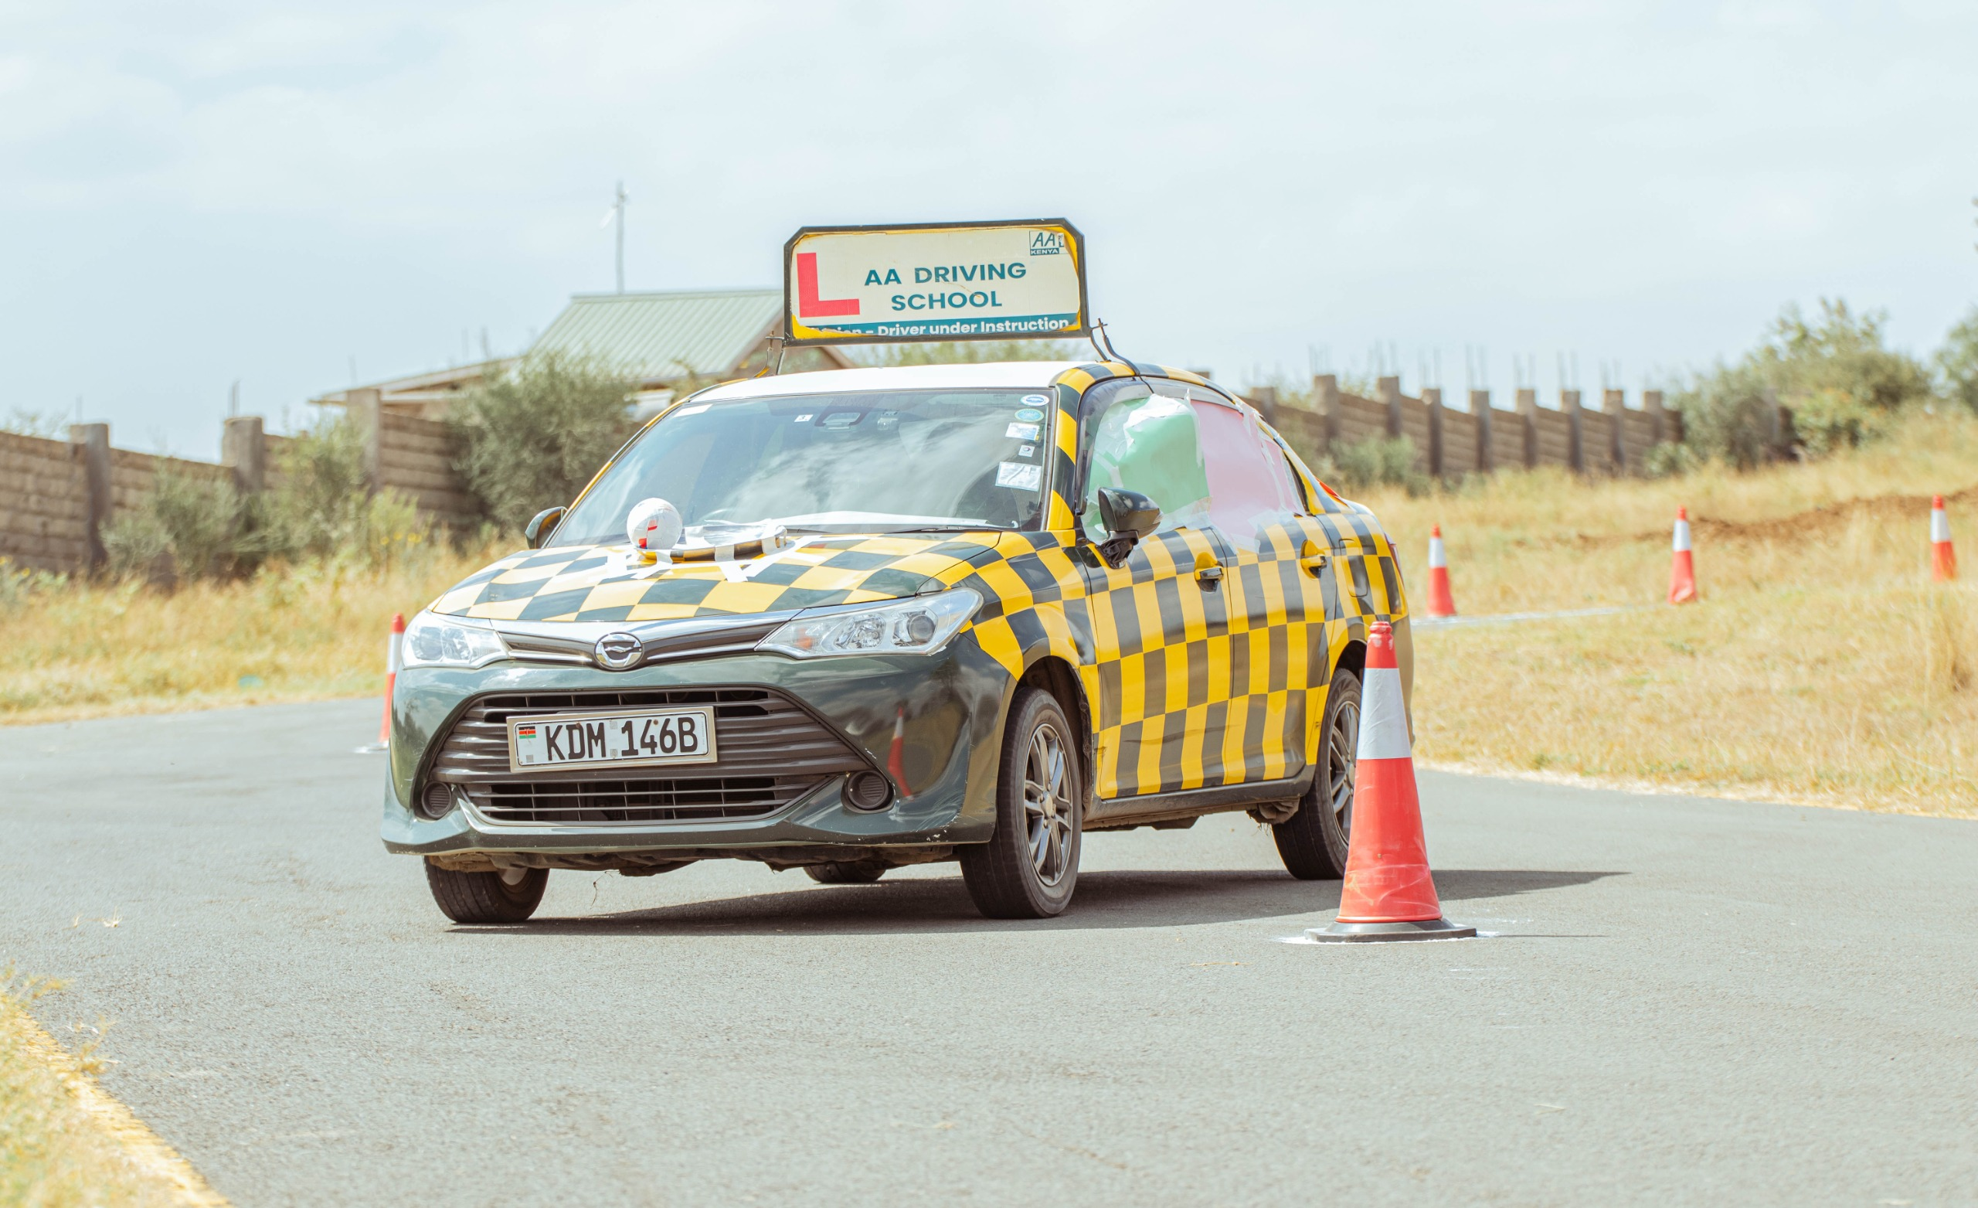
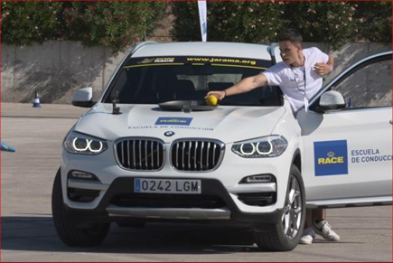
NO.5 : BOWL SLALOM
DESCRIPTION:
Vehicle: 01
Speed:
Minimum speed of 45 kmh
Top speed of 60 kmh
Description
The route (Giant slalom) is marked by cone. The competitor must drive between 2 cones (gate)
Part of the course can be ( not Mandatory) on slippery wet) surface
On the bonnet of the car a bowl is mounted and contains a ball the ball is fixed to the bowl with ropes
If the ball falls out of the bowl the competitor must stop and put the ball back to the container
A maximum time limit will be defined for this task
Penalties:
Cone contact - 05 km/h
Under speed (less than 45 km/h) - 10 km/h
Overspeed (over 60 km/h) - 20 km/h
Spin - 20 km/h
Ball Leaving the BOWEL - 20 km/h
Score:
The result is based on the driven speed minus any possible penalties in kmh. For example, if the driven speed is 50kmh and 2 cones are hit, the result is: 50 – 5 – 5 = 40 points.
# TASKS NO.5

Slide 14
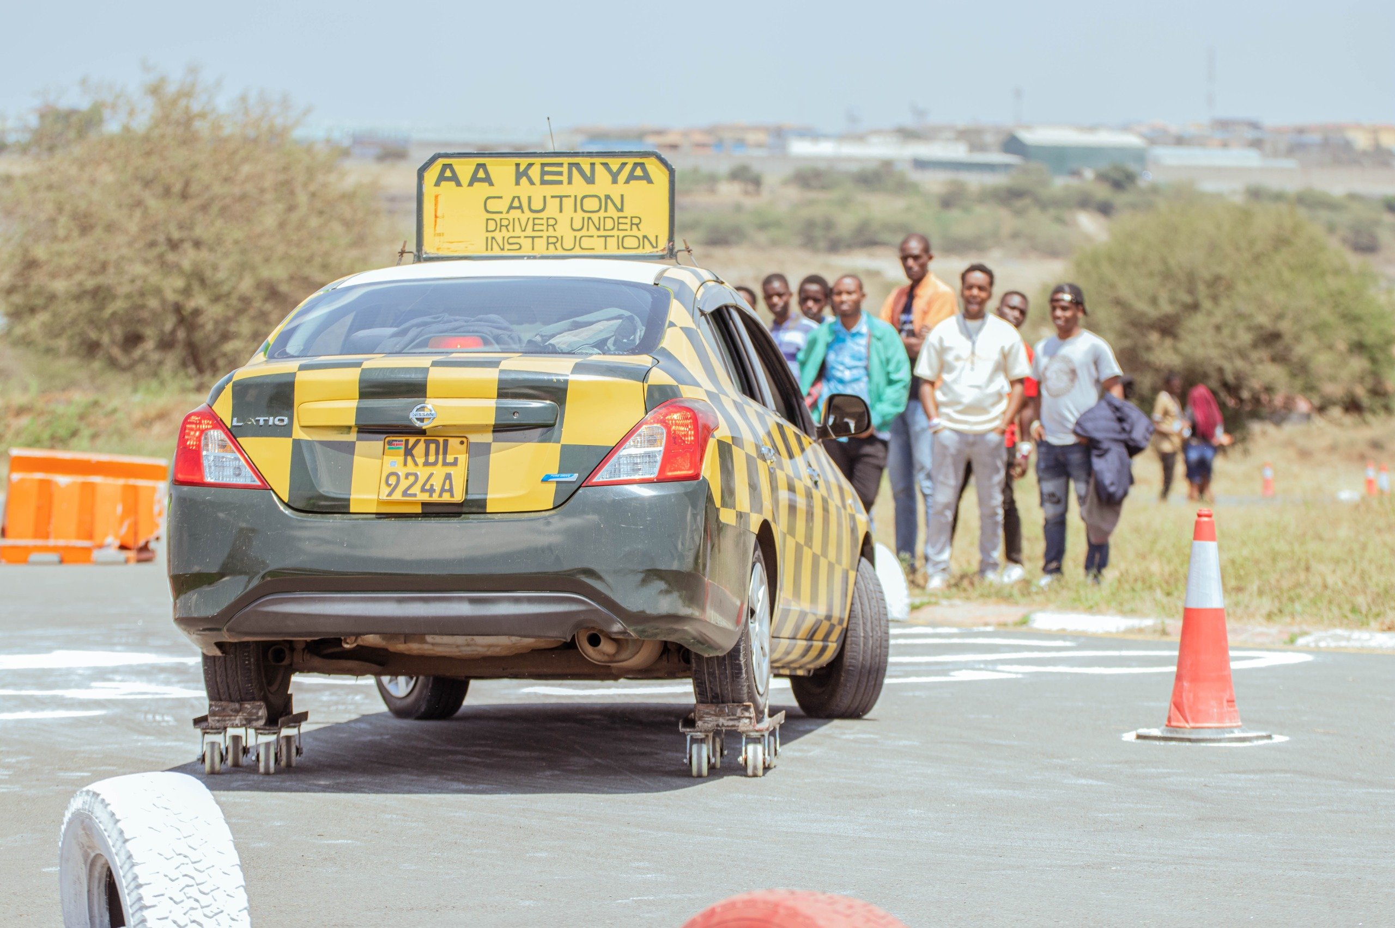
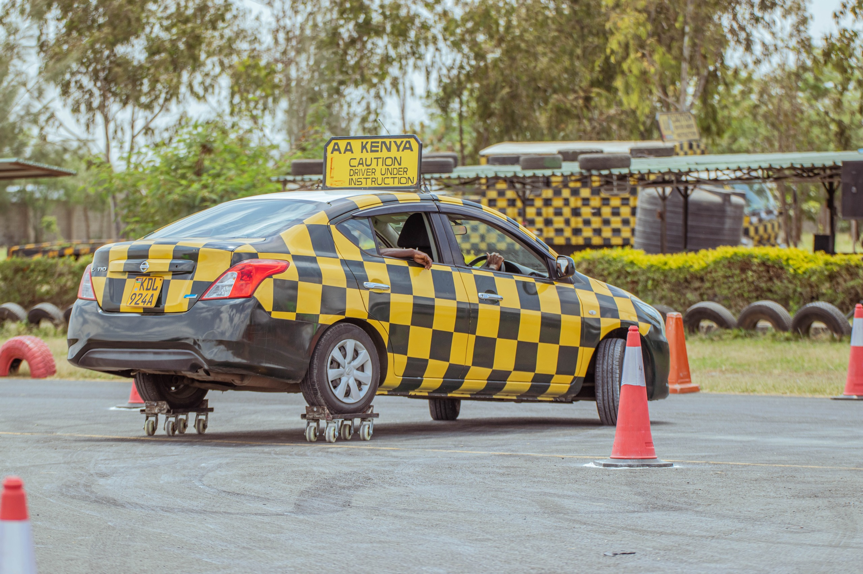
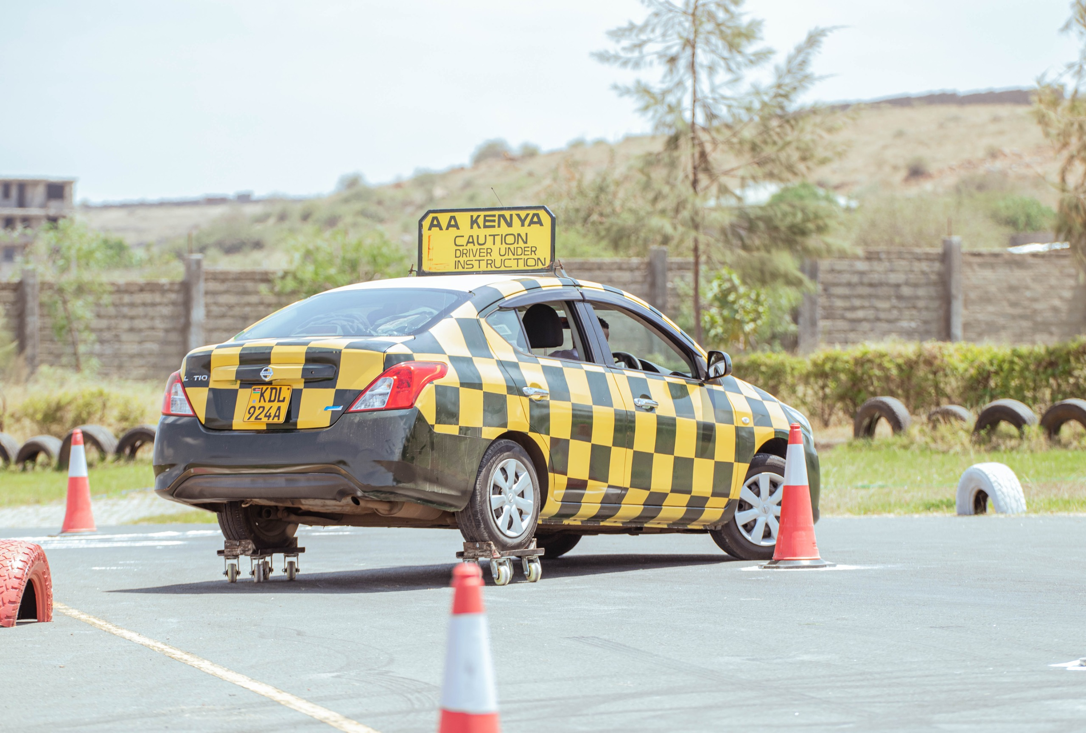
NO.6: ROLL CAR
DESCRIPTION:
Vehicle: 01 Vehicle:
The aim of the exercise is to drive a giant slalom as error free, and as quickly as possible, with a vehicle with unstable rear wheels.
Surface: tarmac.
Starting order will be drawn.
Flying start, finish is stopping in a garage.
Seat belt must be worn
Penalties:
Cone contact + 10 sec
Missing a gate + 15 sec
Not stopping (over braking) in the target garage + 15 sec
Score:
The scoring is based on the fastest time then added penalty seconds. Time + penalty seconds.
For example, if the competitor completes the course in 00:00:40,00 sec, but hit a cone and miss one gate, the result is: 40+ 10 + 15 = 0:01:05:10.
# TASK NO. 6 TASKS
Notes:
14

Slide 15
TIME | TASK 1 | TASK 2 | TASK 3 | TASK 4 | TASK 5 | TASK 6
10.00 – 10.45 | GROUP 1 | GROUP 2 | GROUP 3 | GROUP 4 | GROUP 5 | GROUP 6
10.45 – 11.30 | GROUP 6 | GROUP 1 | GROUP 2 | GROUP 3 | GROUP 4 | GROUP 5
10.30 – 12.15 | GROUP 5 | GROUP 6 | GROUP 1 | GROUP 2 | GROUP 3 | GROUP 4
13.15 – 14.00 | GROUP 4 | GROUP 5 | GROUP 6 | GROUP 1 | GROUP 2 | GROUP 3
14.00 – 14.45 | GROUP 3 | GROUP 4 | GROUP 5 | GROUP 6 | GROUP 1 | GROUP 2
14.45 – 15.30 | GROUP 2 | GROUP 3 | GROUP 4 | GROUP 5 | GROUP 6 | GROUP 1
# SCHEDULE
*Any changes in the task schedule will be communicated timely during the briefing on Friday, 18.07.2025

Slide 16
#WINNER PRIZE
Diffèrent Catégories
WINNERS 2025

